Slide 1
HUMAN COMPUTER INTERACTION
(M23DES212)
School of CSA /MCA- IInd sem
Dr. Ambili P S

Slide 2
Unit- ii contents
Design Process : Design process – Human interaction with computers, importance of human characteristics human consideration, Human interaction speeds, understanding business junctions, Screen Designing:- Design goals – Screen planning and purpose, organizing screen elements, ordering of screen data and content – screen navigation and flow – Visually pleasing composition – amount of information – focus and emphasis.

Slide 3
INTERACTION DESIGN BASICS
Interaction design is about creating interventions in often complex situations using technology of many kinds including PC software, the web and physical devices.
Interaction design is not just about the artifact that is produced, whether a physical device or a computer program, but about understanding and choosing how that is going to affect the way people work.
Design involves:
– achieving goals within constraints
– understanding the raw materials: computer and human
– accepting limitations of humans and of design.

Slide 4
INTERACTION DESIGN BASICS
The design process has several stages and is iterative and never complete.
Interaction starts with getting to know the users and their context:
– finding out who they are and what they are like... probably not like you!
– talking to them, watching them.

Slide 5
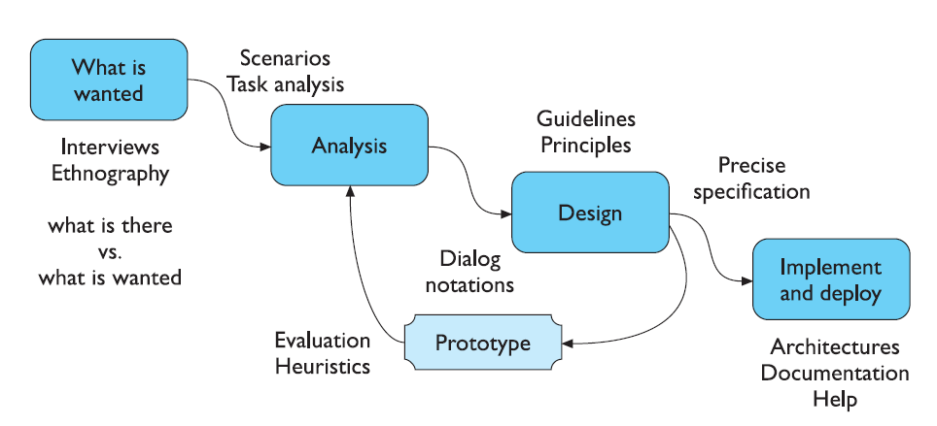
THE PROCESS OF DESIGN
Requirements – what is wanted

Slide 6
Design Process
Obstacles and Pitfalls in the Development Path:
Gould (1988) has made these general observations about design:
  Nobody ever gets it right the first time.
  Development is chock-full of surprises.
  A software team designing a new AI chatbot for customer support realizes late in development that users expect voice interaction, not just text — requiring major changes.
  Good design requires living in a sea of changes.
  A ride-sharing app like Uber frequently updates its UI/UX to adapt to new regulations (e.g., adding emergency button, showing driver mask compliance), user preferences, or to include sustainability features like ride-sharing.
  Making contracts to ignore change will never eliminate the need for change.
  A government portal was developed with fixed contracts for 5 years, disallowing interface changes. But due to a sudden surge in usage during a pandemic, user complaints forced emergency redesigns for accessibility and responsiveness, despite the initial contract.

Slide 7
Design Process
Obstacles and Pitfalls in the Development Path:
  Even if you have made the best system humanly possible, people will still make mistakes when using it.
  ATM Withdrawal Mistakes
  Designers need good tools.
  You must have behavioral design goals like performance design goals.
  Fitness Tracking App:
  Behavioral Goal:Motivate users to adopt a healthier lifestyle—like walking more, sleeping better, or reducing screen time.
  Performance Goal:Accurately record steps, heart rate, sleep cycles, and calories burned.

Slide 8
Design Process
Pitfalls in the design process exist because of a flawed design process, including a failure to address critical design issues, an improper focus of attention, or development team organization failures.
Common pitfalls are:
No early analysis and understanding of the user’s needs and expectations.
A focus on using design features or components that are “neat” or “glitzy.”
Little or no creation of design element prototypes.
No usability testing.
No common design team vision of user interface design goals.
Poor communication between members of the development team.

Slide 9
Designing for People: The Five Commandments
Gain a complete understanding of users and their tasks
Solicit early and ongoing user involvement.
Perform rapid prototyping and testing
Modify and iterate the design as much as necessary
Integrate the design of all the system components

Slide 10
HUMAN INTERACTION WITH COMPUTERS
Understanding How People Interact with Computers
Characteristics of computer systems, past and present, that have caused, and are causing, people problems.
The effect these problems have –
Why people have trouble with computers
Responses to poor design
People and their tasks

Slide 11
Why People Have Trouble with Computers
Extensive technical knowledge but little behavioral training.
With its extensive graphical capabilities.
Poorly designed interfaces.
Use of jargon
Non-obvious design
Fine distinctions
Disparity in problem-solving strategies
an "error-preventing" strategy
Design inconsistency

Slide 12
Typical psychological responses to poor design
Confusion: Detail overwhelms the perceived structure. Meaningful patterns are difficult to ascertain, and the conceptual model or underlying framework cannot be understood or established.
  An online banking dashboard displays all transactions, billers, investment options, and ads on the homepage without proper categorization. New users struggle to find where to initiate a fund transfer.
Annoyance: Inconsistencies in design, slow computer reaction times, difficulties in quickly finding information, outdated information, and visual screen distractions are a few of the many things that may annoy users.
  An e-commerce app displays items as "in stock," but when users try to purchase them, the items are actually unavailable. The inconsistent feedback causes repeated failed attempts.
Frustration: Frustration is heightened if an unexpected computer response cannot be undone or if what really took place cannot be determined: Inflexible and unforgiving systems are a major source of frustration.
  A form on a government website resets all fields if the user makes a mistake in one entry, with no error explanation. Users are forced to re-enter everything from scratch, unsure what went wrong.

Slide 13
Typical psychological responses to poor design
Panic or stress: Unexpectedly long delays during times of severe or unusual pressure may introduce panic or stress. Some typical causes are unavailable systems or long response times when the user is operating under a deadline or dealing with an irate customer.
  Example: Online Exam Portals During a competitive online exam (e.g., GATE, NEET, or a university final exam).
Boredom: Boredom results from improper computer pacing (slow response times or long download times) or overly simplistic jobs.
  A data entry employee working with outdated legacy software has to wait 5–10 seconds between screen transitions. The monotonous wait drains attention and motivation.
DREAMS OF THE GREAT EARTH CHANGES

Slide 14
psychological responses to poor design
These psychological responses diminish user effectiveness because they are severe blocks to concentration.
    Thoughts irrelevant to the task at hand are forced to the user’s attention, and necessary concentration is impossible.
    The result, in addition to higher error rates, is poor performance, anxiety, and dissatisfaction. Physical.

Slide 15
Important Human Characteristics in Design
Importance in design are
perception,
memory,
visual acuity,
foveal and peripheral vision,
sensory storage,
information processing,
learning,
skill, and
individual differences

Slide 16
Perception
Perception is our awareness and understanding of the elements and objects of our environment through the physical sensation of our various senses, including sight, sound, smell, and so forth.
Perceptual characteristics include the following:
  Proximity.
  Similarity.
  Matching patterns
  Succinctness.
  Closure.
  Unity.
  Continuity.

Slide 17
Memory
Memory is not the most stable of human attributes, as anyone who has forgotten why they walked into a room, or forgotten a very important birthday, can attest.
memory is viewed as consisting of two components, long-term and short-term (or working) memory
Short-term, or working, memory receives information from either the senses or longterm memory, but usually cannot receive both at once, the senses being processed separately.
Long-term memory contains the knowledge we possess. Information received in short-term memory is transferred to it and encoded within it, a process we call learning.

Slide 18
Sensory Storage
Sensory storage is the buffer where the automatic processing of information collected from our senses takes place.
It is an unconscious process, large, attentive to the environment,quick to detect changes, and constantly being replaced by newly gathered stimuli. In a sense, it acts like radar, constantly scanning the environment for things that are important to pass on to higher memory

Slide 19
Memory
  Minimize the need for a mighty memory.
Other general ways to reduce user memory loads, reduce the need for mental integration, and expand working memory, thus enhancing system usability include:
Presenting information in an organized, structured, familiar, and meaningful way.
Placing all required information for task performance in close physical proximity.
Giving the user control over the pace of information presentation.

Slide 20
Visual Acuity
The capacity of the eye to resolve details is called visual acuity.
It is the phenomenon that results in an object becoming more distinct as we turn our eyes toward it and rapidly losing distinctness as we turn our eyes away
It has been shown that relative visual acuity is approximately halved at a distance of 2.5 degrees from the point of eye fixation (Bouma, 1970).
Therefore, a five-degree diameter circle centered around an eye fixation character on a display has been recommended as the area near that character (Tullis, 1983) or the maximum length for a displayed word (Danchak, 1976).
If one assumes that the average viewing distance of a display screen is 19 inches (475 mm), the size of the area on the screen of optimum visual acuity is 1.67 inches (41.8 mm) in diameter.

Slide 21
Visual Acuity
The eye’s sensitivity increases for those characters closest to the fixation point (the “0”) and decreases for those characters at the extreme edges of the circle (a 50/50 chance exists for getting these characters correctly identified).

Slide 22
Foveal and Peripheral Vision
Foveal vision is used to focus directly on something; peripheral vision senses anything in the area surrounding the location we are looking at, but what is there cannot be clearly resolved because of the limitations in visual acuity just described.
Foveal and peripheral vision maintain, at the same time, a cooperative and a competitive relationship. Peripheral vision can aid a visual search, but can also be distracting.
In its cooperative nature, peripheral vision is thought to provide clues to where the eye should go next in the visual search of a screen.
In its competitive nature, peripheral vision can compete with foveal vision for attention.
Mori and Hayashi (1993) experimentally evaluated the effect of windows in both a foveal and peripheral relationship and found that performance on a foveal window deteriorates when there are peripheral windows, and the performance degradation is even greater if the information in the peripheral is dynamic or moving.

